Slide 1

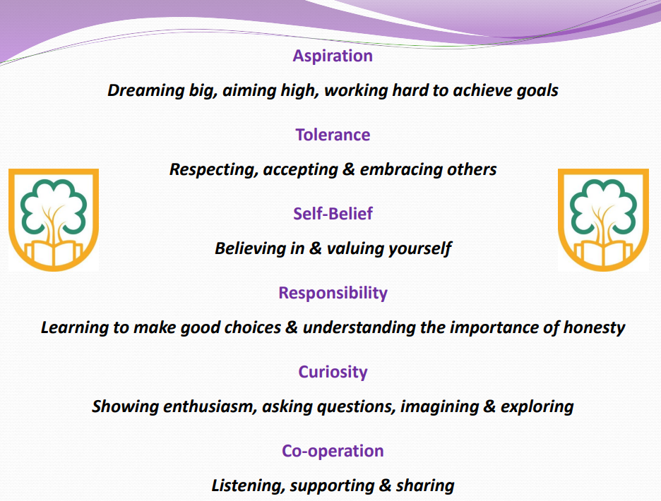
July 2026
‘Challenging minds, changing futures’
School Core Values

Slide 2
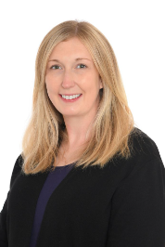
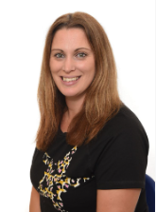
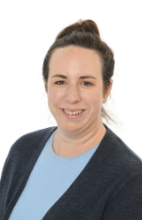
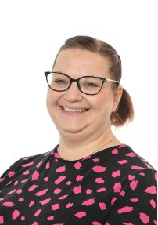
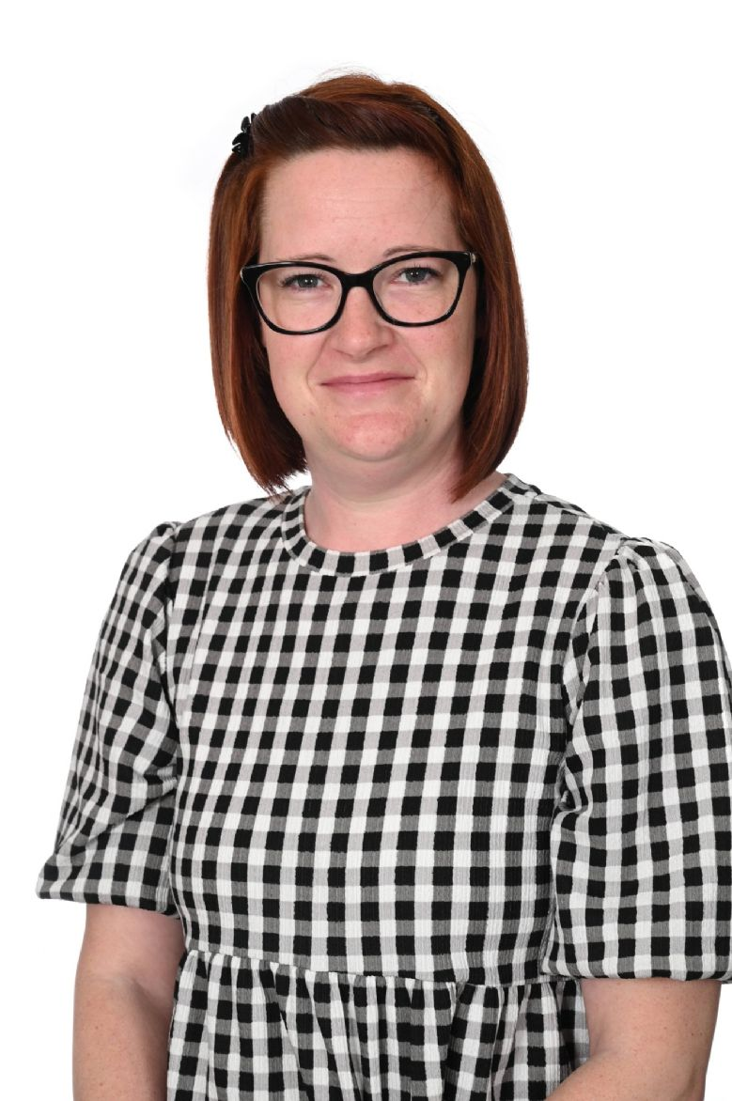
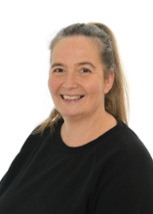
Welcome to Foundation Stage
Mrs Clarke
(Monday – Wednesday)
Mrs Tipper
(Thursday-Friday)
Mrs Cox
HLTA
(Teacher/TA cover)
Mrs Saunders
HLTA
(Teacher/TA cover)
Miss Green
TA (full time)
Mrs Giles
TA (part time)

Slide 3

Starting School Transition

Slide 4



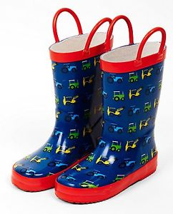
Things to Bring to School
There is no expectation that you must have uniform with our logo on and many items from our uniform list are readily available within high street stores, local supermarkets and through our pre-loved uniform available from Friends of Downsway. If you would like to purchase any of our school uniform from our supplier, including items with our logo on, it is Michael Hope Sports Ltd - www.michaelhope.co.uk
PE: Please can children wear their PE kit to school on a Friday, from the 11th September.
We will start getting changed in school in the Summer Term.
Please name all items

Slide 5
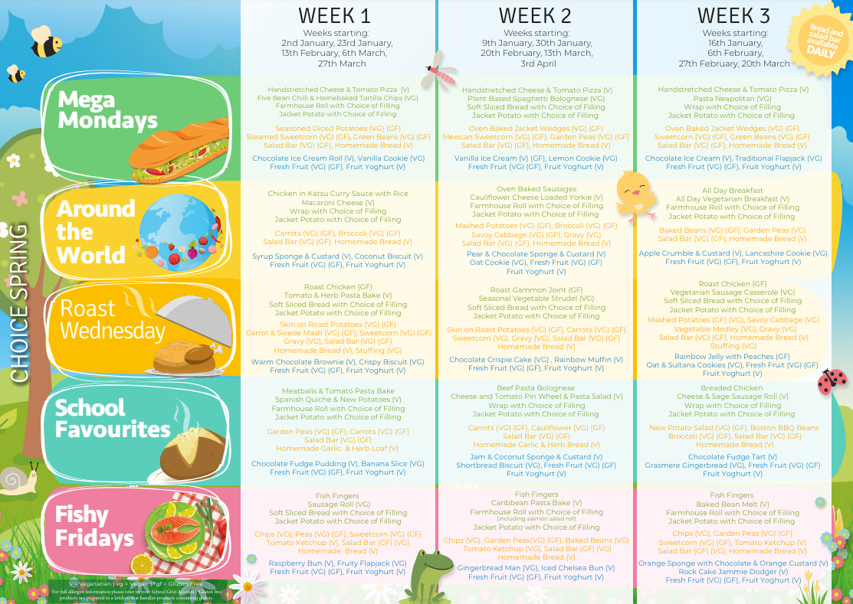
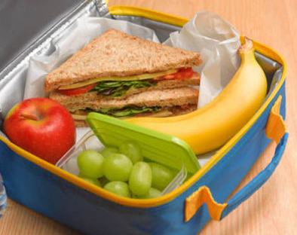




Lunchtimes and Cool Milk
Please pre-order lunches at home
School Grid: You will be sent a log in link
Adults will support children going into the hall for lunch.
We encourage children to try new things and support children that find eating new things challenging.
No products containing nuts.
Milk is free while your child is 4 years old. Parents can choose to pay when their child turns 5. We have milk and fruit at snack time during the morning all together on the carpet. Children may bring in their own fruit snack from home.

Slide 6
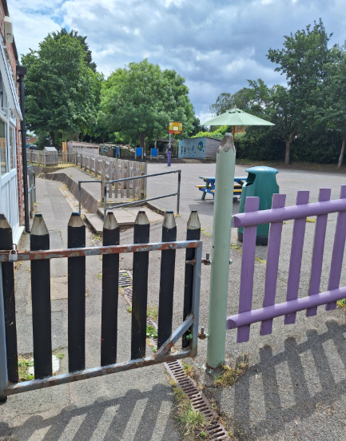
Dropping off and picking up
Our school day starts at 8.55am and the children go home at 3.05pm.
Start of the school day: Please can the children wait on the main playground. The small gate will then be opened by a member of staff at 8.45am and the children will then walk into the classroom to put their things away.
End of the school day: Please wait by the same gate on the main playground until a member of staff opens it at 3pm. Please then walk into the garden area and an adult will then call the children one at a time from the carpet area to come and meet their grown-up outside the classroom door.

Slide 7

Attendance at Downsway Primary
We recognise that regular attendance at school is very important if a child is to make good educational progress at school. Consequently, we do everything we can to ensure that children enjoy coming to school.
Attendance Target:
99-100%: Excellent
96-98%: Good
95%: Satisfactory
Below 95%: Cause for concern

Slide 8
School Houses
Every child at Downsway is placed in one of our four schoolhouses when they start.
Lovelace
Luther King
Darwin
Shakespeare
The children will learn about the influential people who each house is named after. They will be awarded house points for displaying our school values.
25 house points = a bronze badge
50 house points = a silver badge
100 house points = a gold badge.

Slide 9
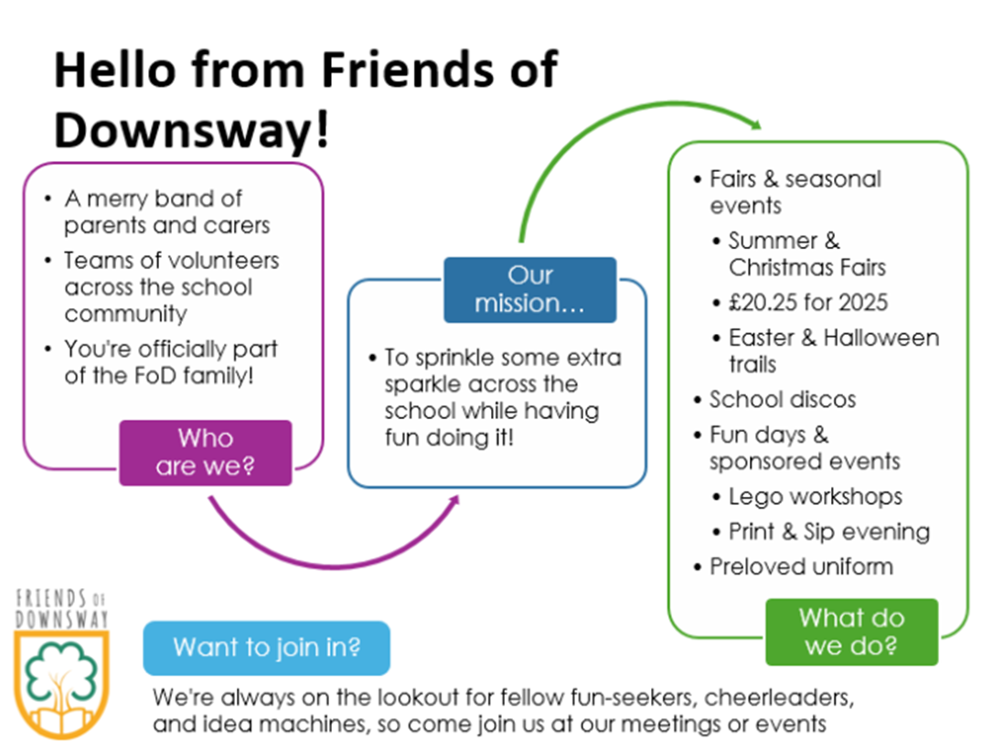
Friends of Downsway

Slide 10

Mighty All Stars Wrap Around Care
Breakfast Club - Monday - Friday
7.45am - 8.45am
After School Care Club Full Session - Monday to Friday
3.15pm - 6.00pm
To Book:
Please register and book your ASC space by clicking the link and selecting Downsway;
https://mightyallstars.ipalbookings.com
Email Address:
mightyallstarsipal@gmail.com

Slide 11

Parent Helpers
To support our reading programme in school.
This involves:
Listening to children read
Changing reading books
Helping children to change their library books
If you can volunteer for any of these roles, it would be a regular commitment, we currently change our reading books on a Tuesday and a Friday. This could be a shared role.
Library books are changed on a Thursday afternoon.
There is some paperwork that would need to be completed
along with a DBS check.
Please contact the school office or speak to a member of
the team if you are interested or would like more information.

Slide 12

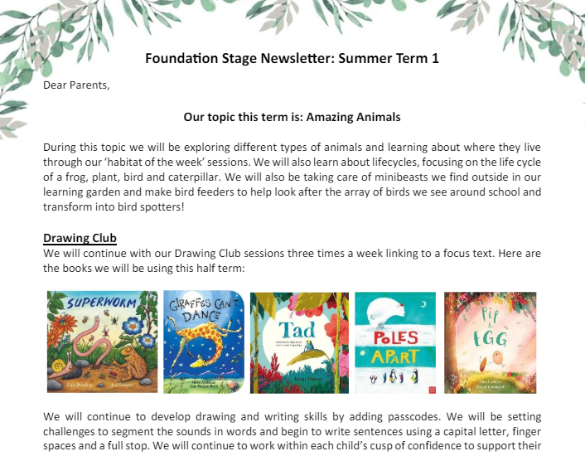
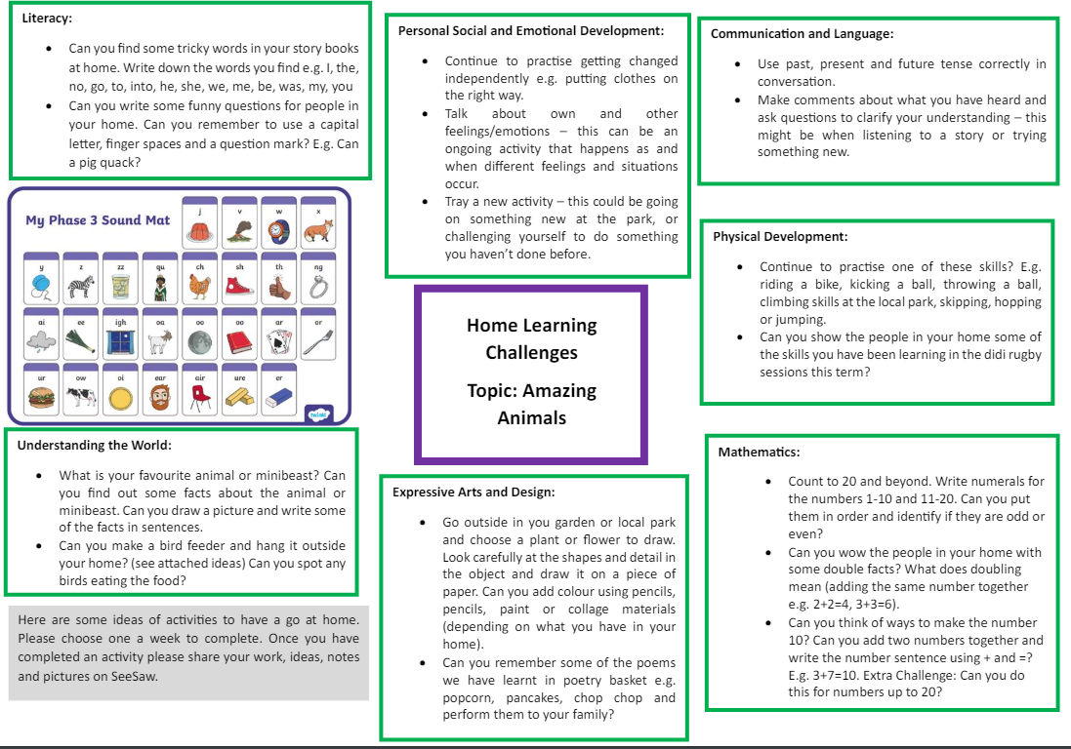
Parent Communication and Newsletters
We will keep you informed with all that is happening at Downsway Primary School via email through the school office.
Mrs Ayres sends out a monthly school newsletter.
You will also receive a Foundation Stage newsletter, topic map and home learning grid at the beginning of every half term. These are also saved on the school website.

Slide 13


Parents as Partners
Your knowledge about your child’s learning and development is so important to us.
We use SeeSaw (an online communication platform) to share big events, experiences and ‘wow’ moments in school. You will be given log in details once your child has started school.
On Seesaw you can share:
Any learning that takes place at home with us in school.
Wow moments for example learning to ride a bike, swimming lessons
Children’s interests to inform our planning
Welcome Time: Classroom Drop-in Sessions
An opportunity to look at your child’s books throughout the year on specific dates and times.
School website

Slide 14


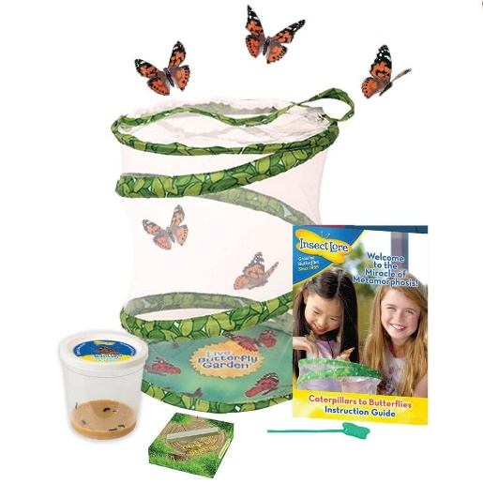


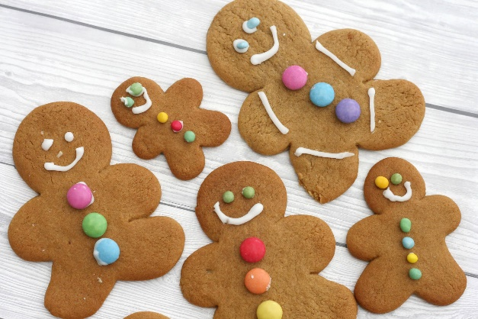
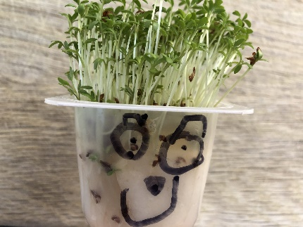
Trips and Experiences
In Foundation, many of the activities we organise are school-based due to the young age of the children. We plan one trip out of school in the summer term.

Slide 15

Curriculum and Learning
We aim to create a fun, caring and positive approach to learning.
In Foundation Stage we are building on the children’s previous knowledge.
Practical play experiences are very important at this stage of development.
We plan exciting topics throughout the year!
Children learn to be…
Resilient Capable Confident Self-assured

Slide 16
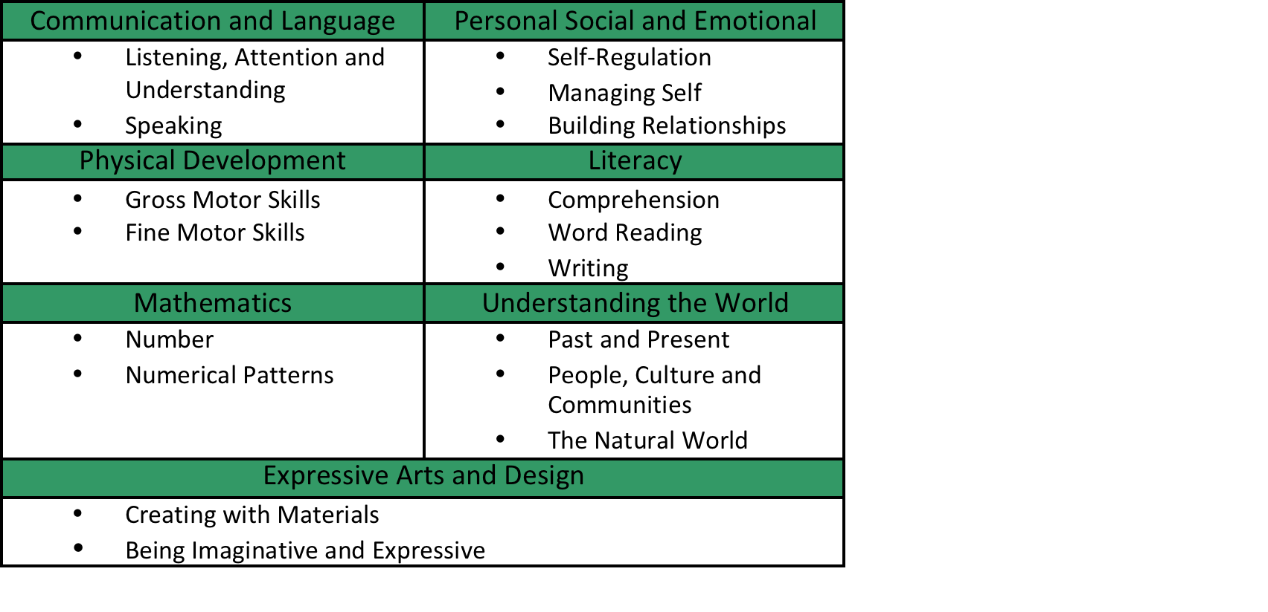
Curriculum and Learning:
Early Years Foundation Stage
We follow the Early Years Foundation Stage Framework which is implemented by the Government. There are 17 Early Learning Goals that we help the children work towards.

Slide 17
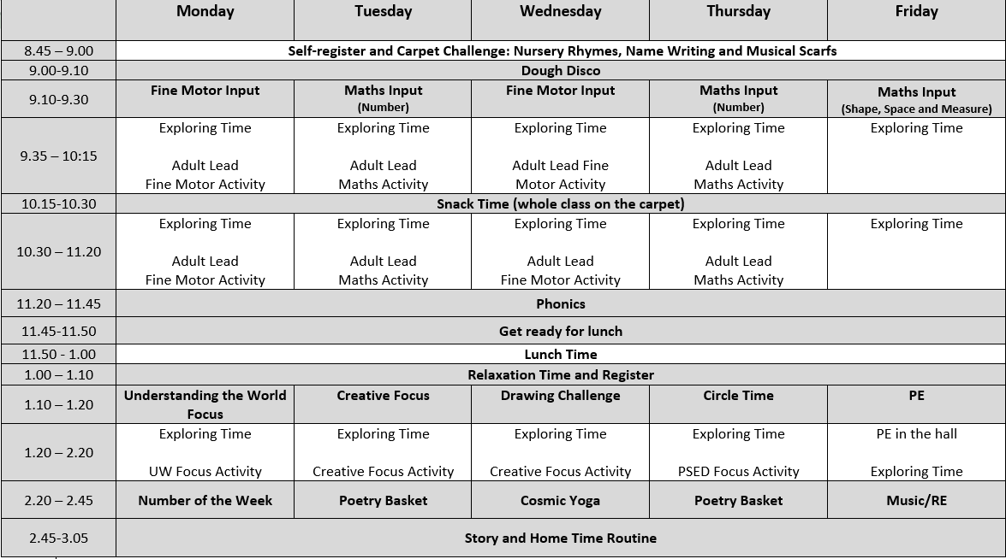
Autumn Term Timetable

Slide 18
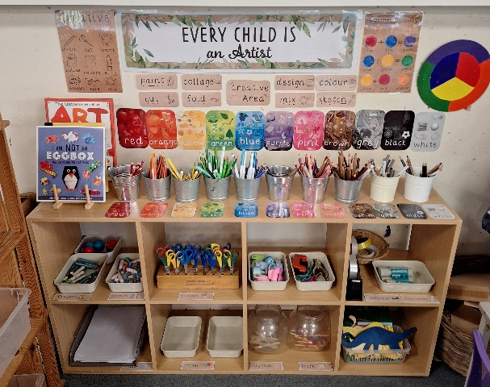
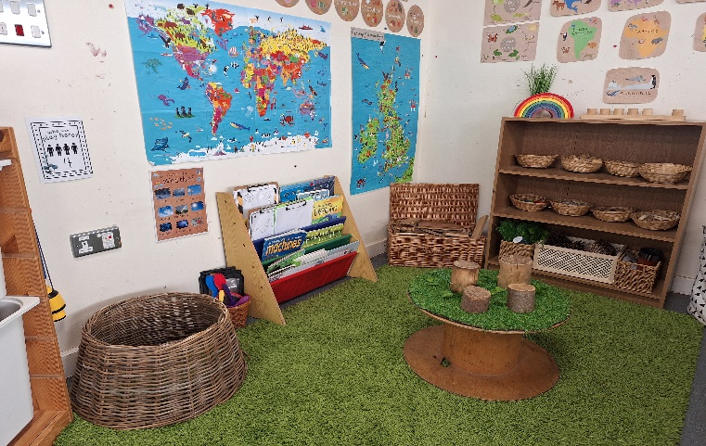
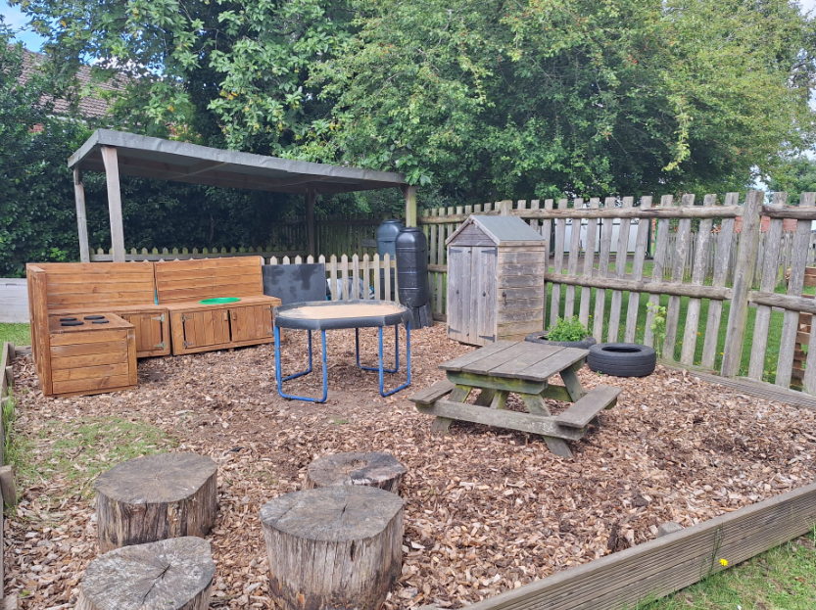
What is Exploring Time?
Free-flow independent play and planned exploration opportunities within the indoor and outdoor learning environments.
Children self-select resources, practise new ideas and skills; they take risks, show imagination and solve problems.
Focus on developing a love of learning, independence and resilience.
Adults support children during exploring time through observation and questioning to move children’s learning on.
Children also take part in planned small group adult-lead Literacy (Drawing Club) and Mathematics activities while other children are exploring.

Slide 19
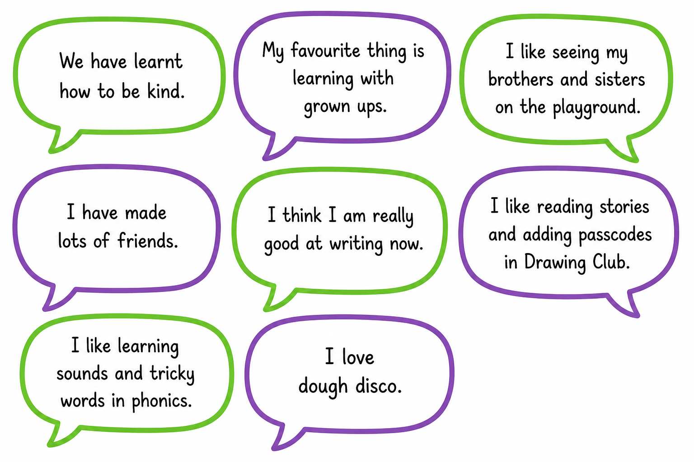

What the Children Say

Slide 20
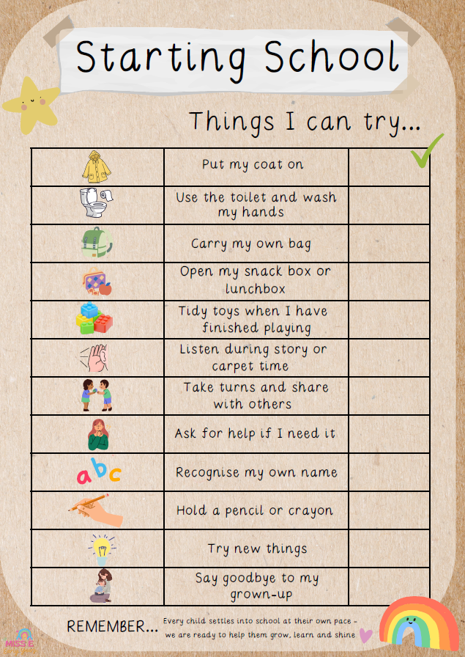
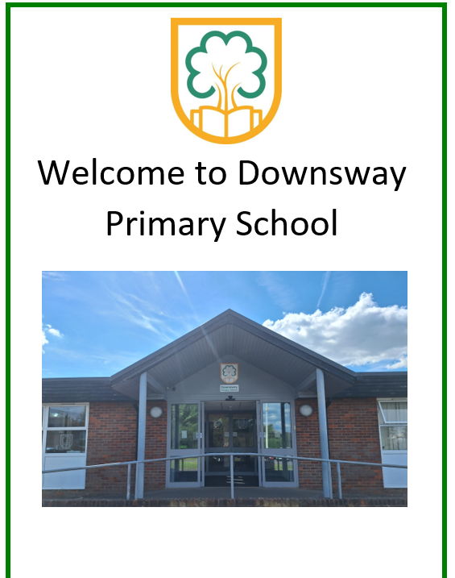
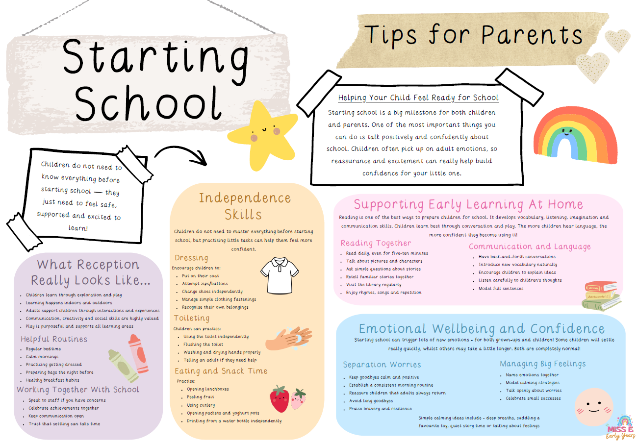
Q & A
Please collect a copy before you leave
And Finally…
These documents can also be found on the Foundation class page of the school website

