Slide 1

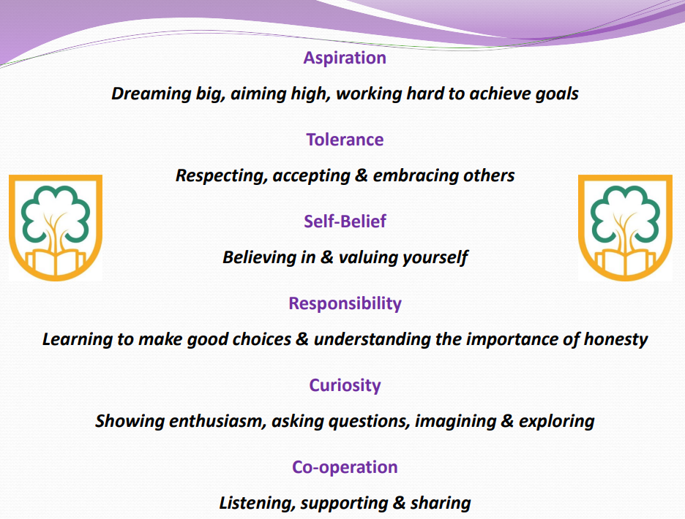
July 2025
Downsway Primary School
‘Challenging minds, changing futures’
School Core Values

Slide 2
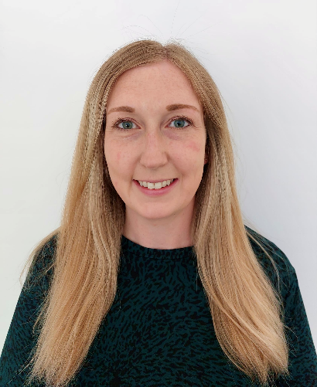
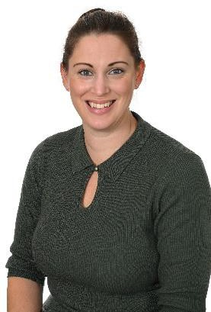
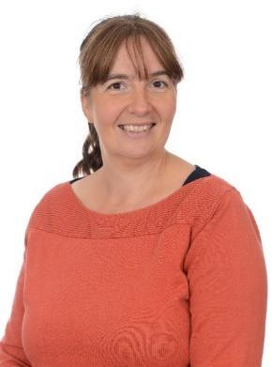
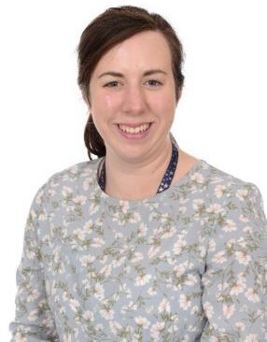
Welcome to Foundation Stage
Mrs Clarke
(Monday – Wednesday)
Mrs Tipper
(Thursday-Friday)
Mrs Saunders
Higher Level Teaching Assistant
(mornings/afternoons throughout the week)
Miss Green
Teaching Assistant (full time)

Slide 3

Starting School Transition

Slide 4





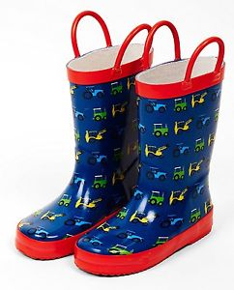
Things to Bring to School
There is no expectation that you must have uniform with our logo on and many items from our uniform list are readily available within high street stores, local supermarkets and through our pre-loved uniform available from Friends of Downsway. If you would like to purchase any of our school uniform from our supplier, including items with our logo on, it is Michael Hope Sports Ltd - www.michaelhope.co.uk
Please name all items

Slide 5
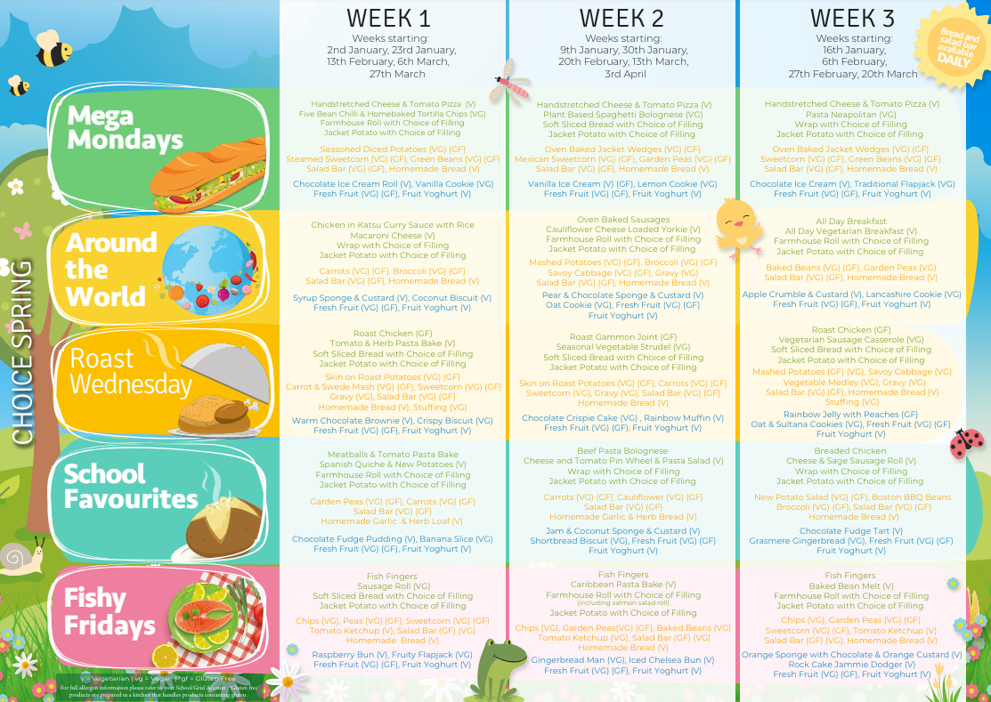
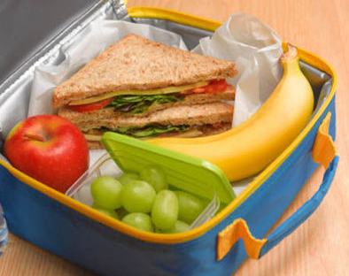



Lunchtimes and Cool Milk
Please pre-order lunches at home
School Grid: You will be sent a log in link
Adults will support children going into the hall for lunch.
We encourage children to try new things and support children that find eating new things challenging.
No products containing nuts.
Cool milk is free while your child is 4 years old. Parents can choose to pay when their child turns 5. We have milk and fruit at snack time during the morning.

Slide 6
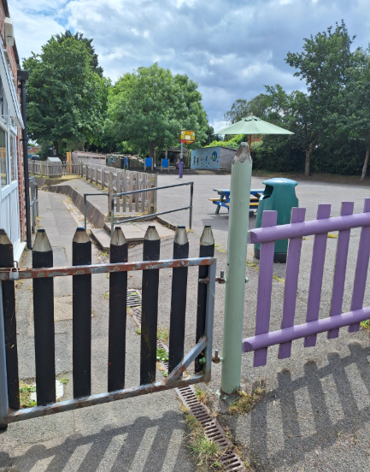
Dropping off and picking up
Our school day starts at 8.55am and the children go home at 3.05pm.
Start of the school day: Please can the children wait on the main playground. The small gate will then be opened by a member of staff at 8.45am and the children will then walk into the classroom to put their things away.
End of the school day: Please wait by the same gate on the main playground until a member of staff opens it at 3pm. An adult will then call the children one at a time from the carpet area to come and meet their grown-up outside the classroom door.

Slide 7

Attendance at Downsway Primary
We recognise that regular attendance at school is very important if a child is to make good educational progress at school. Consequently, we do everything we can to ensure that children enjoy coming to school.
Attendance Target:
99-100%: Excellent
96-98%: Good
95%: Satisfactory
Below 95%: Cause for concern

Slide 8
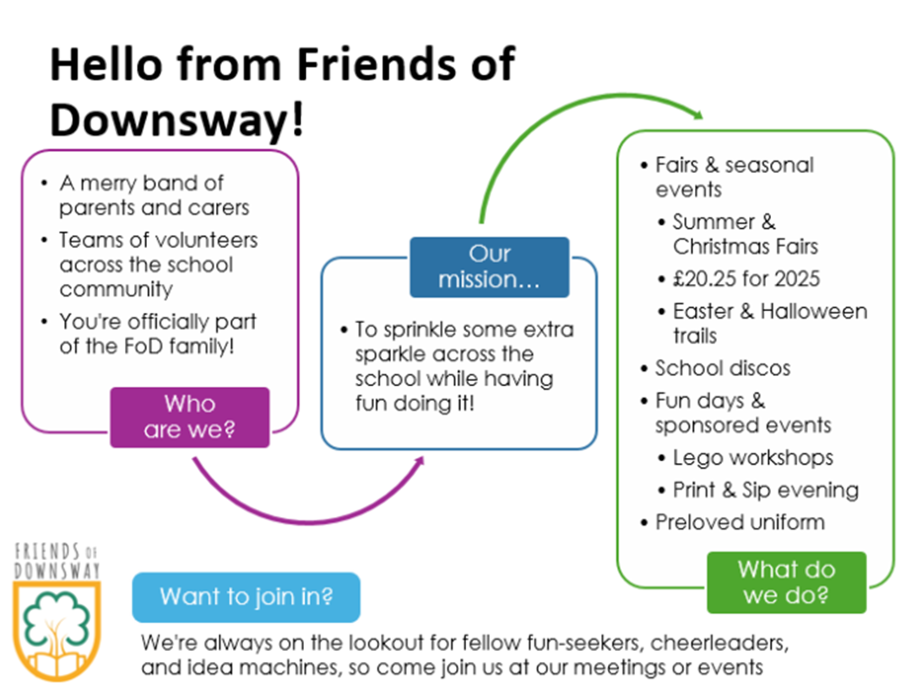
Friends of Downsway

Slide 9

Mighty All Stars Wrap Around Care
Breakfast Club - Monday - Friday
7.45am - 8.45am
After School Care Club Full Session - Monday to Friday
3.15pm - 6.00pm
To Book:
Please register and book your ASC space by clicking the link and selecting Downsway;
https://mightyallstars.ipalbookings.com
Email Address:
mightyallstarsipal@gmail.com

Slide 10

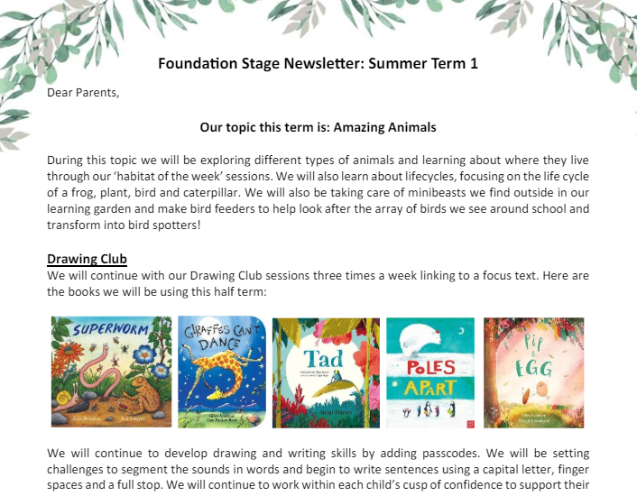
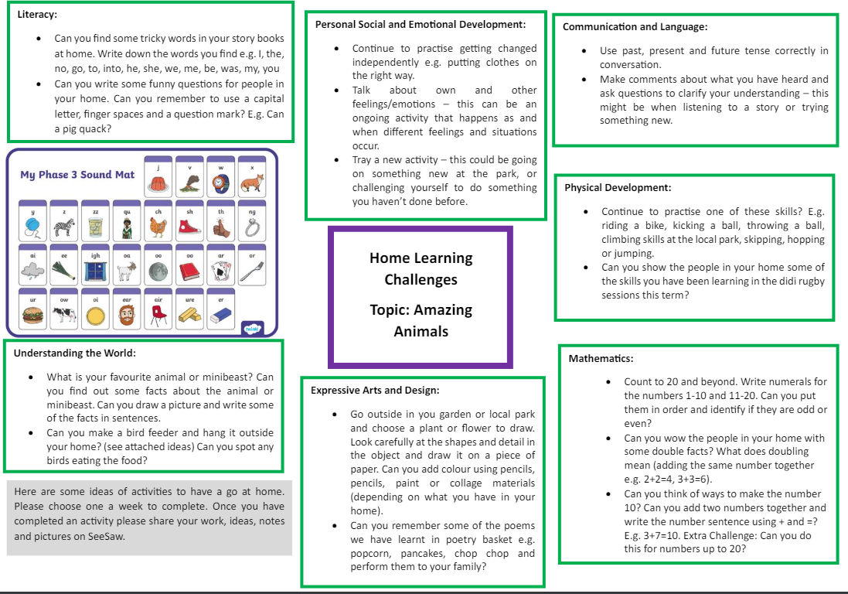
Parent Communication and Newsletters
We will keep you informed with all that is happening at Downsway Primary School via email through the school office.
Mrs Ayres sends out a monthly school newsletter.
You will also receive a Foundation Stage newsletter, topic map and home learning grid at the beginning of every half term. These are also saved on the school website.

Slide 11


Parents as Partners
Your knowledge about your child’s learning and development is so important to us.
We use SeeSaw (an online communication platform) to share big events, experiences and ‘wow’ moments in school. You will be given log in details once your child has started school.
On Seesaw you can share:
Any learning that takes place at home with us in school.
Wow moments for example learning to ride a bike, swimming lessons
Children’s interests to inform our planning
Welcome Time: Classroom Drop-in Sessions
An opportunity to look at your child’s books throughout the year on specific dates and times.
School website

Slide 12

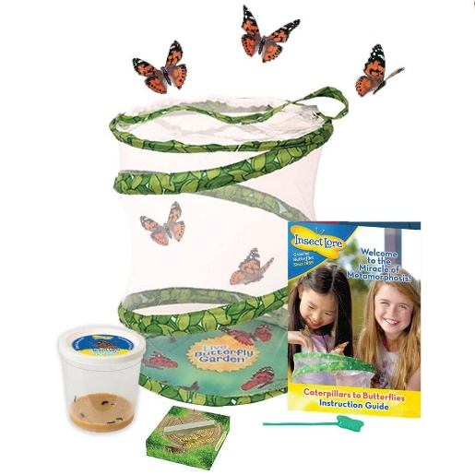




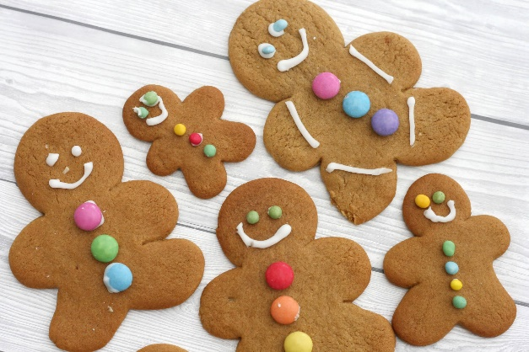
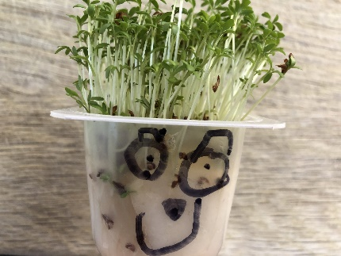
Trips and Experiences
In Foundation, many of the activities we organise are school-based due to the young age of the children. We plan one trip out of school in the summer term.

Slide 13

Curriculum and Learning
We aim to create a fun, caring and positive approach to learning.
In the Foundation Stage we are building on the children’s previous knowledge.
Practical play experiences are very important at this stage of development.
We plan exciting topics throughout the year!
Children learn to be…
Resilient Capable Confident Self-assured

Slide 14
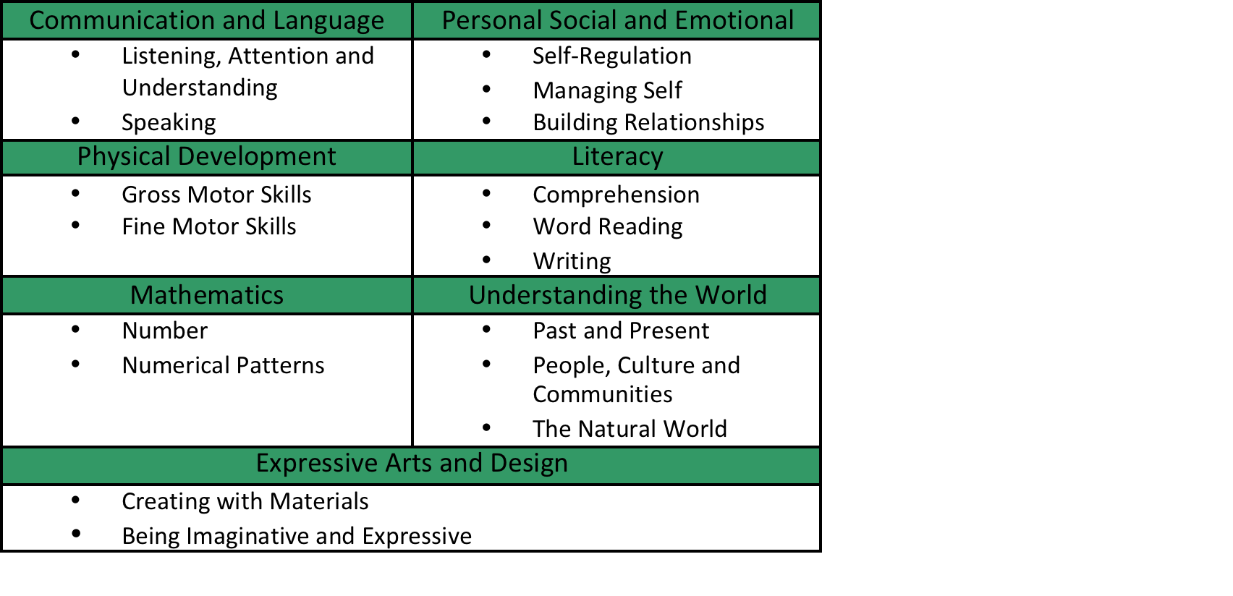
Curriculum and Learning:
Early Years Foundation Stage
We follow the Early Years Foundation Stage Framework which is implemented by the Government. There are 17 Early Learning Goals that we help the children work towards.

Slide 15
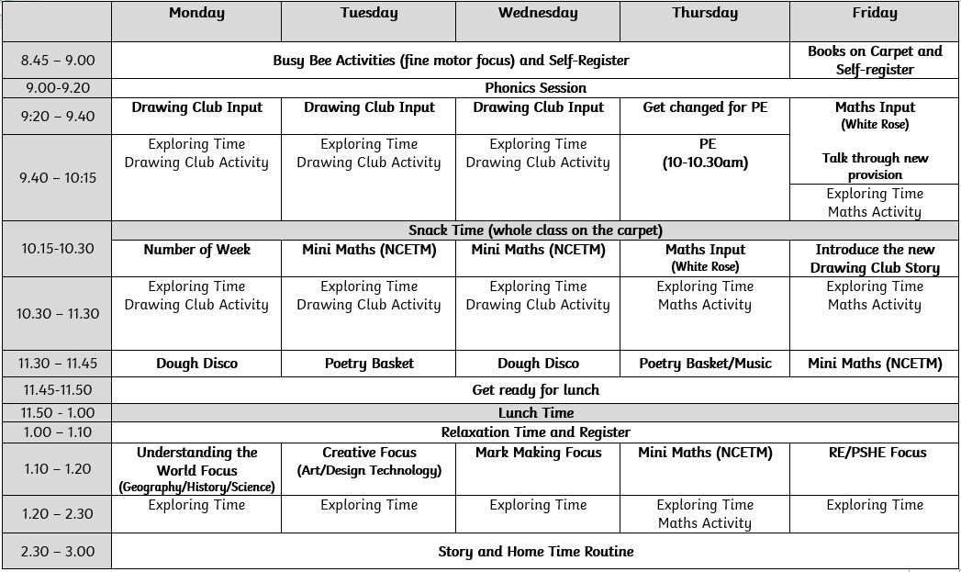
Autumn Term Timetable

Slide 16
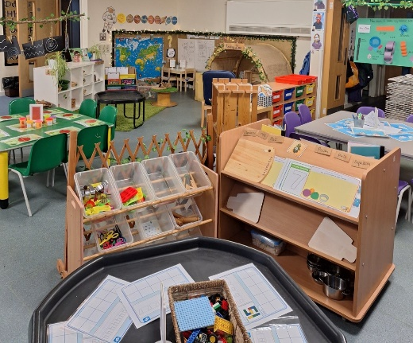
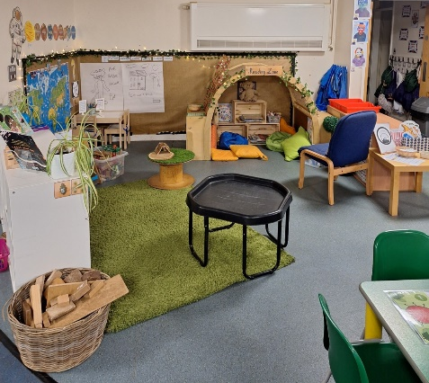
What is Exploring Time?
Free-flow independent play and planned exploration opportunities within the indoor and outdoor learning environments.
Children self-select resources, practise new ideas and skills; they take risks, show imagination and solve problems.
Focus on developing a love of learning, independence and resilience.
Adults support children during exploring time through observation and questioning to move children’s learning on.
Children also take part in planned small group adult-lead Literacy (Drawing Club) and Mathematics activities while other children are exploring.

Slide 17

What the Children Say
We have learnt how to be kind.
My favourite thing is learning with grown ups.
I like seeing my brothers and sisters on the playground.
I have made lots of friends.
I think I am really good at writing now.
I like reading stories and adding passcodes in Drawing Club.
I like learning sounds and tricky words in phonics.
Taking part in Didi rugby lessons is really fun.
I love dough disco.

Slide 18
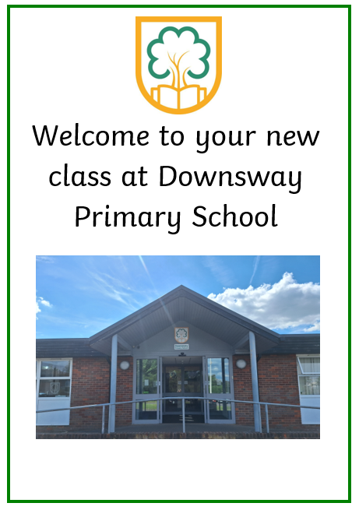

‘Challenging minds, changing futures’
Q & A
Please collect a copy before you leave
And Finally…
This document is on the Foundation class page of the school website

